Slide 1
Chapter 5: The Link Layer – Links, Access, Networks, and LANs
Freshman Seminar
2022.03.02
Sumin Sohn

Slide 2
Contents
5.1 Introduction to the link layer
5.2 Error-detection and –correction techniques
5.3 Multiple access links and protocols
5.4 Switched local area networks

Slide 3
5.1 Introduction to the link layer

Slide 4
Terminology
Node
Any device that runs in link-layer protocol
E.g., host, router, switch, WiFi access point
Link
Communication channel that connect adjacent nodes
Link-layer frame
Over a given link, transmitting node encapsulate datagram in link-layer frame
Consist of data field(datagram) and headers
Structure is specified by link-layer protocol

Slide 5
Services of Link Layer #1
Basic service: move a datagram from one node to adjacent node over link
Possible services by link-layer protocol
Framing
Encapsulate each network-layer datagram within a link-layer frame
Link access
Medium Access Control(MAC) protocol specifies rules by which frame is transmitted onto link
When multiple nodes share a single broadcast link
MAC protocol serve to coordinate frame transmission of many nodes
Reliable delivery
Guarantee to move each network-layer datagram across the link without error
Often used for links that are prone to high error rates with goal of correcting error locally
E.g., wireless link

Slide 6
Services of Link Layer #2
(Cont.) Possible services by link-layer protocol
Error detection and correction
Bit errors are introduced by signal attenuation and electro-magnetic noise
Error detection is usually more sophisticated and implemented in hardware
For error correction,
Receiver detect bit error in frame
And also, determine where in frame errors have occurred

Slide 7
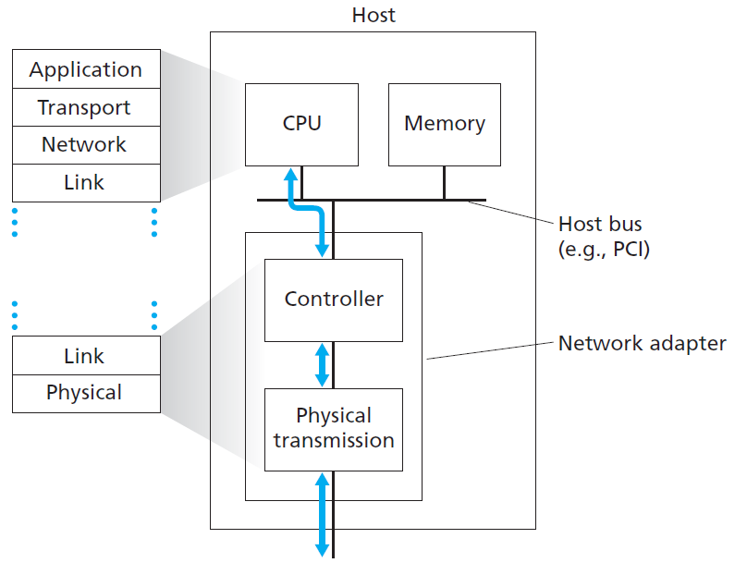
Link-Layer Implementation in Hardware
For most part, link layer is implemented in network adapter
Known as Network Interface Card(NIC)
Attached to host’s bus
Heart of network adapter is link-layer controller
Implements of many link-layer services
Framing, link access, error detection, etc.
Much of controller’s functionality is implemented in hardware
Notes:
End system의 link layer에 포커싱

Slide 8
Link-Layer Implementation in Software
Part of link layer is implemented in software
Run on host’s CPU
Implement high-level functionality
Assemble link-layer addressing information
Activate controller hardware
E.g., on receiving side,
Respond to controller interrupt
Handle error condition and pass datagram up to network layer
Thus, link layer is combination of HW and SW

Slide 9
5.2 Error-detection and –correction techniques

Slide 10
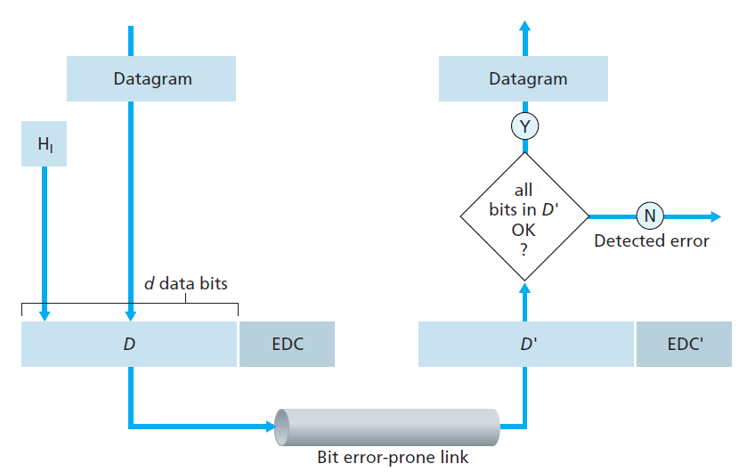
Error Detection and Correction Scenario
Sender
Data is protected against bit errors with Error-Detection and Correction bits(EDC)
Data include
Datagram
Link-layered packet
Receiver
Determine whether or not received D’ is same as original D
Sometimes, there still may undetected bit errors
Should be small possibility of such errors
Notes:
Undetected bit error가 작을 수 있도록 하는게 필요
약간의 trade off가 생기게 됨
정교할수록 undetected bit error는 줄겠지만,
그만큼의 오버헤드도 고려해야하니까

Slide 11
Three Techniques for Detecting Errors
Parity check
Basic idea behind error detection and correction
Checksumming method
Typically used in transport layer
Cyclic redundancy check
Typically used in link layer

Slide 12
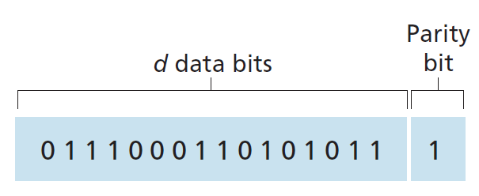
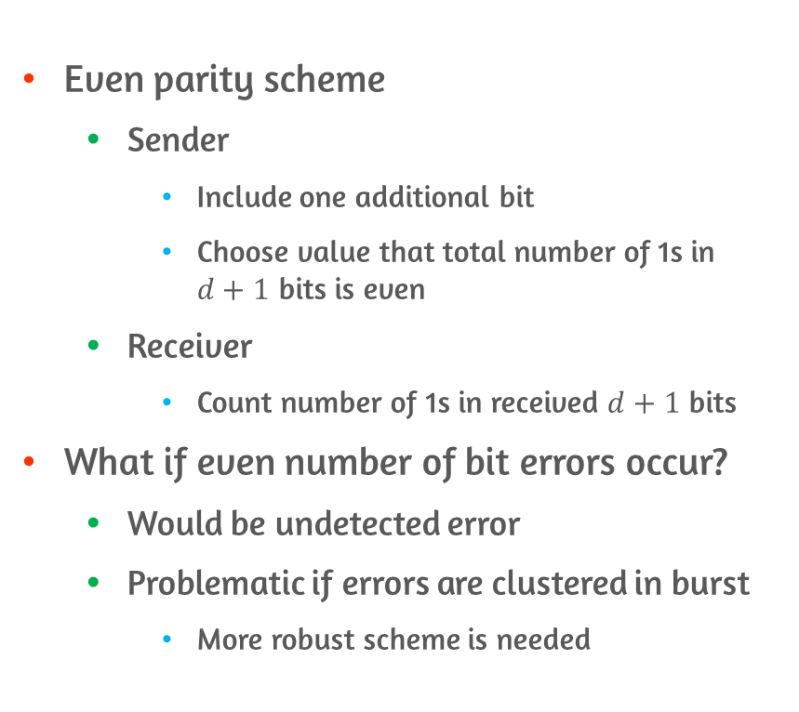
Single Parity Bit Checks
Even parity scheme
Sender
Include one additional bit
Choose value that total number of 1s in $d+1$ bits is even
Receiver
Count number of 1s in received $d+1$ bits
What if even number of bit errors occur?
Would be undetected error
Problematic if errors are clustered in burst
More robust scheme is needed
Even parity scheme
Notes:
Single bit check는 error가 클러스터되어서 터지는 경우 문제가 될 수 있음

Slide 13
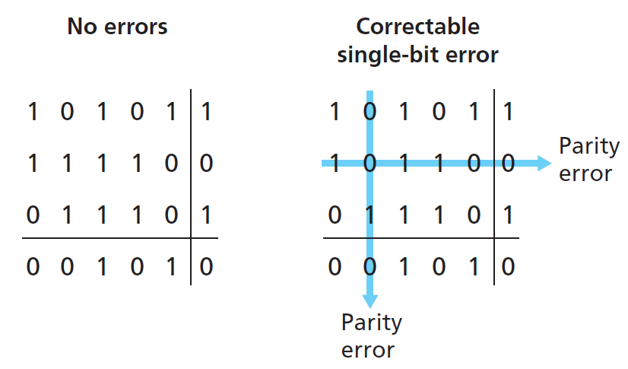
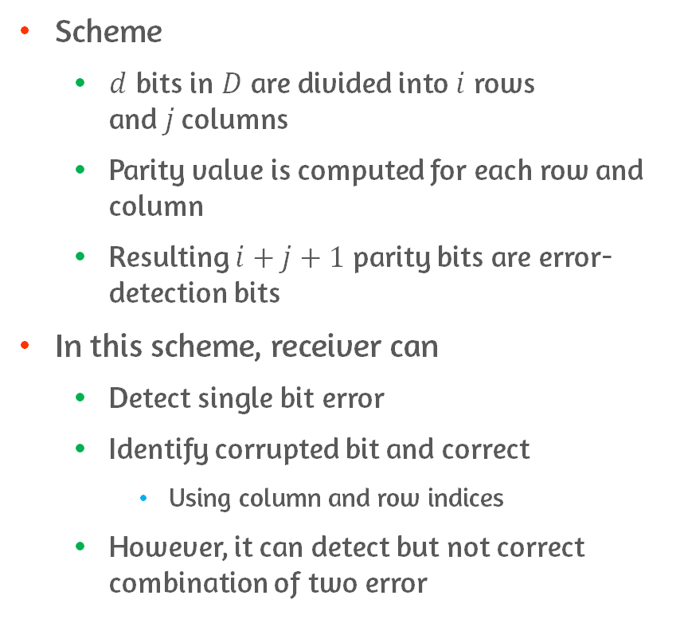
Two-Dimensional Parity Scheme
Scheme
$d$ bits in $D$ are divided into $i$ rows and$j$columns
Parity value is computed for each row and column
Resulting $i+j+1$ parity bits are error-detection bits
In this scheme, receiver can
Detect single bit error
Identify corrupted bit and correct
Using column and row indices
However, it can detect but not correct combination of two error

Slide 14
Forward Error Correction(FEC)
Ability of receiver to both detect and correct errors
Values of FEC
Used with link layer ARQ
Decrease number of sender retransmission required
Allow for immediate correction of errors at receiver
No delay for sender to receive NAK and for retransmitted packet to propagate to receiver

Slide 15
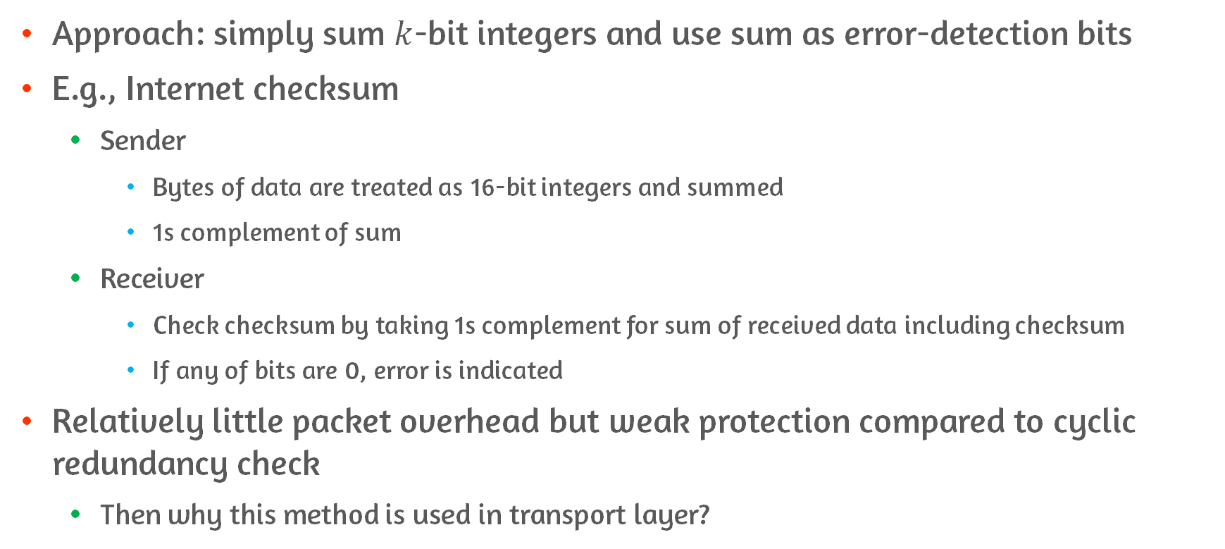
Checksumming Methods
Approach: simply sum $k$-bit integers and use sum as error-detection bits
E.g., Internet checksum
Sender
Bytes of data are treated as 16-bit integers and summed
1s complement of sum
Receiver
Check checksum by taking 1s complement for sum of received data including checksum
If any of bits are 0, error is indicated
Relatively little packet overhead but weak protection compared to cyclic redundancy check
Then why this method is used in transport layer?

Slide 16
Different Error Handling in Each Layers
Transport layer is implemented in software
Important to have simple and fast error-detection scheme
Such as, checksumming
Link layer is implemented in dedicated hardware in adapter
Rapidly perform more complex operations
Notes:
Link layer는 전용 하드웨어인 adapter에 구현되어있음

Slide 17
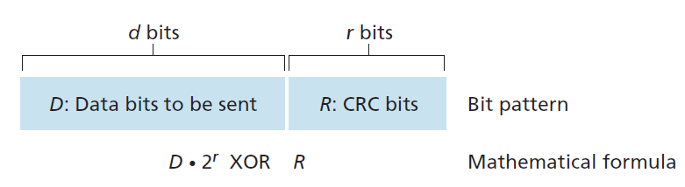
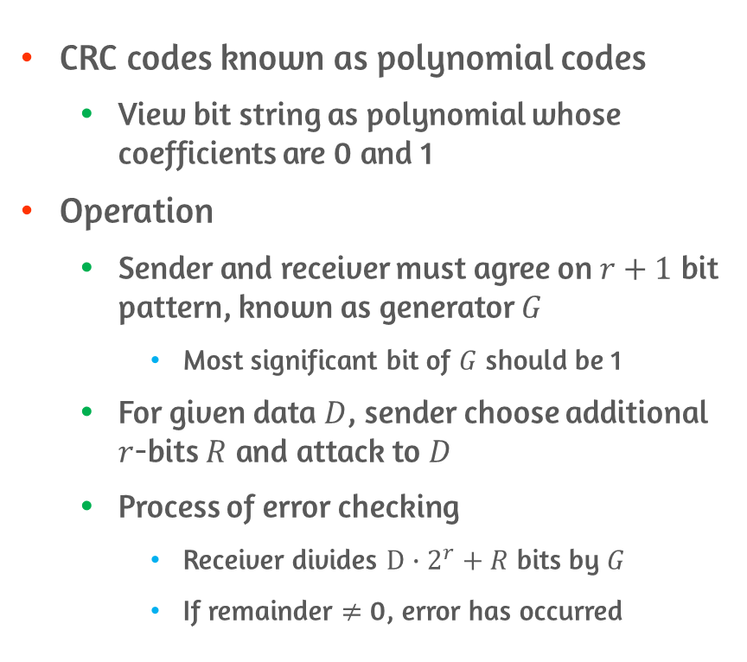
Cyclic Redundancy Check(CRC) Codes
CRC codes known as polynomial codes
View bit string as polynomial whose coefficients are 0 and 1
Operation
Sender and receiver must agree on $r+1$ bit pattern, known as generator $G$
Most significant bit of $G$ should be 1
For given data $D$, sender choose additional $r$-bits $R$ and attack to $D$
Process of error checking
Receiver divides $D∙2^{r}+R$ bits by $G$
If remainder $≠$ 0, error has occurred

Slide 18
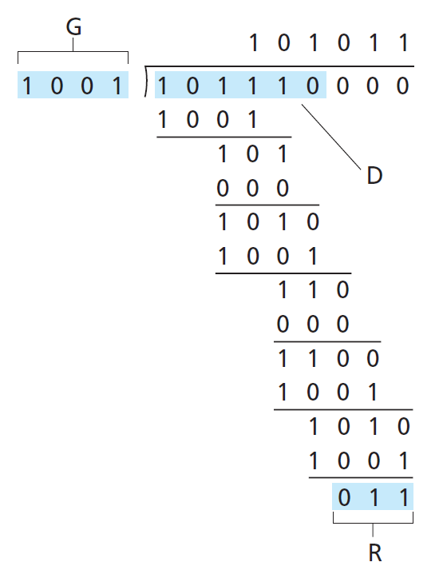
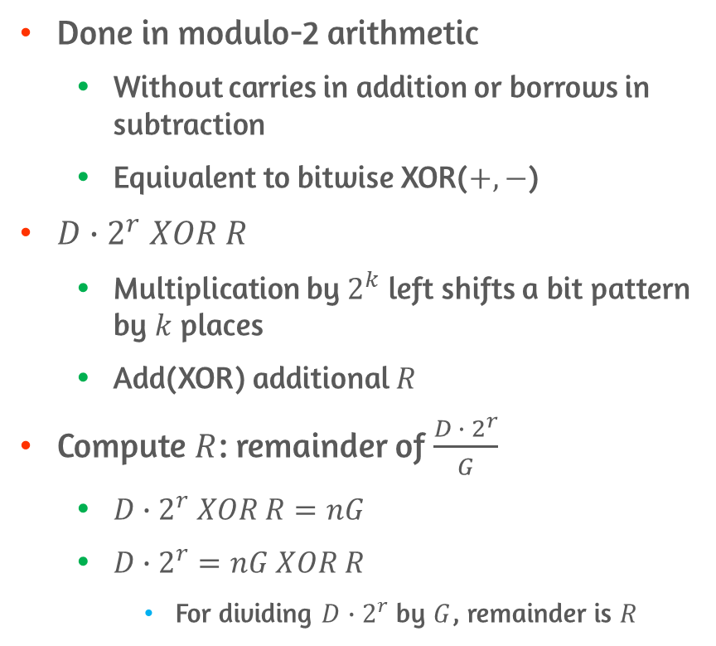
CRC Calculations
Done in modulo-2 arithmetic
Without carries in addition or borrows in subtraction
Equivalent to bitwise XOR($+,−$)
$D∙2^{r} XOR R$
Multiplication by $2^{k}$ left shifts a bit pattern by $k$ places
Add(XOR) additional $R$
Compute $R$: remainder of $\frac{D ∙ 2^{r}}{G}$
$D∙2^{r} XOR R=nG$
$D∙2^{r}=nG XOR R$
For dividing $D∙2^{r}$ by $G$, remainder is $R$
Example of Calculating R

Slide 19
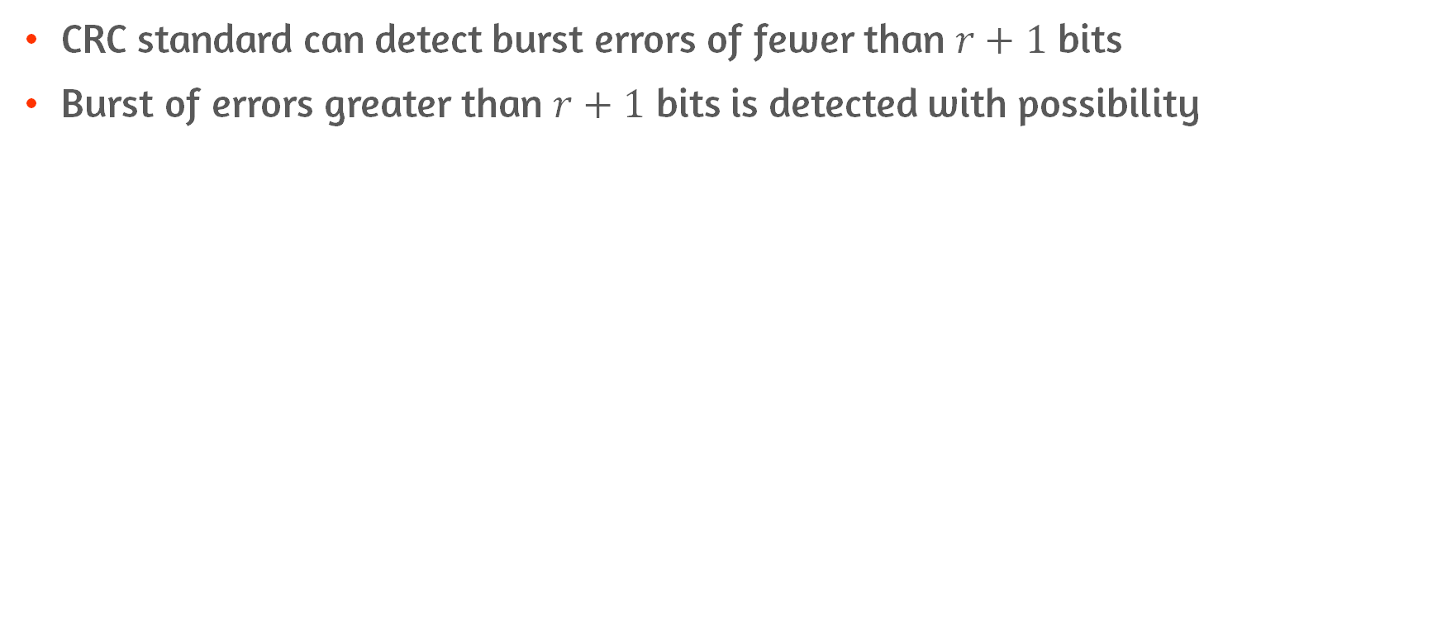
Error Detection of CRC
CRC standard can detect burst errors of fewer than $r+1$ bits
Burst of errors greater than $r+1$ bits is detected with possibility

Slide 20
5.3 Multiple access links and protocols

Slide 21
Two Types of Network Links
Point-to-point link
Consist of single sender and single receiver at each end of the link
Broadcast link
Have multiple sending and receiving nodes
Connected to same, single, shared broadcast channel
Collide occurs if over two node use same link at the same time
E.g., ethernet and wireless LANs

Slide 22
Multiple Access Protocol
Nodes regulate their transmission into shared broadcast channel
By multiple access protocol
Because all nodes are capable of transmitting frames,
More than two nodes can transmit frames at same time
All of nodes receive multiple frames at same time
In a sense, signals of colliding frames become tangled together
All frames involved in collision are lost
Broadcast channel is wasted during collision interval
Notes:
Shared channel에 대한 node의 접근을 어떻게 조정. 편성할 것인가
In a sense, 어떤 의미에서는

Slide 23
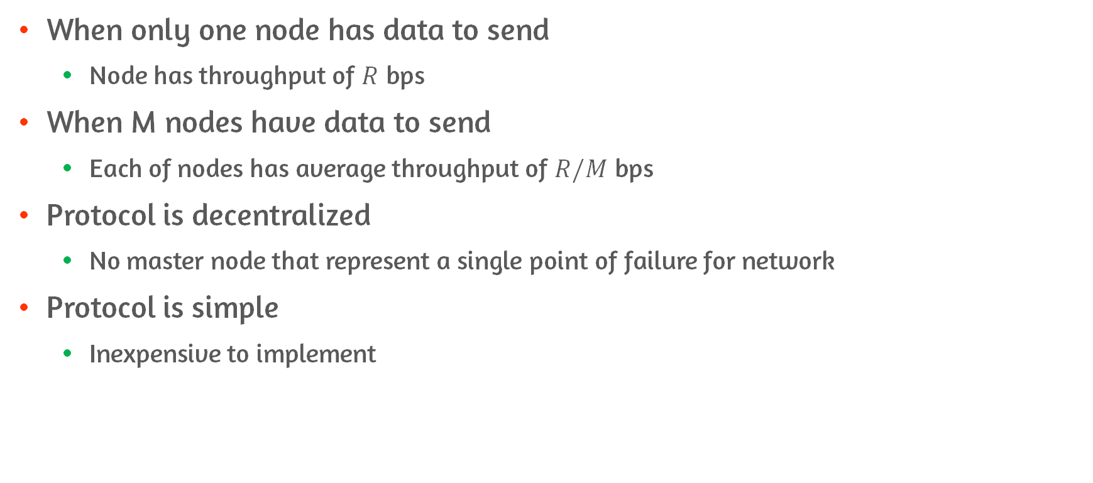
Desirable Characteristics of Multiple Access Protocol
When only one node has data to send
Node has throughput of $R$ bps
When M nodes have data to send
Each of nodes has average throughput of $R/M$ bps
Protocol is decentralized
No master node that represent a single point of failure for network
Protocol is simple
Inexpensive to implement

Slide 24
Three Categories of Multiple Access Protocol
Channel partitioning protocols
Random access protocols
Taking-turns protocols
Notes:
Channel Partitioning: 채널을 여러 작은 조각들로 나누어서 분배한다.(time slots, frequency, code) 즉 각각 노드마다 배타적인 사용을 하기 위해서 할당한다고 볼 수 있겠다.
Random access: 이건 그냥 보내고 싶을 때 보내는 방법이라고 할 수 있다. Collision을 수용하는 방식이라고 생각하면 된다. 이는 채널에 속해 있는 단말의 수가 적을 때 택할 수 있는 방법이다. 만약 Collision이 발생하면, 그냥 다시 보낸다!
Taking turns: 돌아가면서 보낼 수 있는 방법을 말한다. 다 똑같이 보낼 시간을 주는 것이 아닌, 보내려는 양이 더 많은 노드의 경우에는 더 오랫동안 보낼 수 있다.
https://team00csduck.tistory.com/157

Slide 25
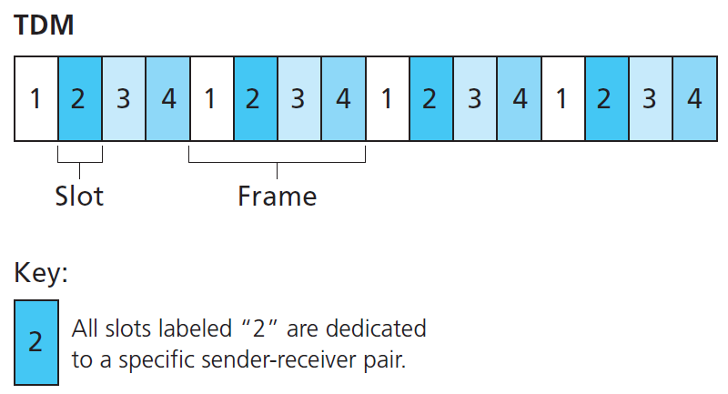
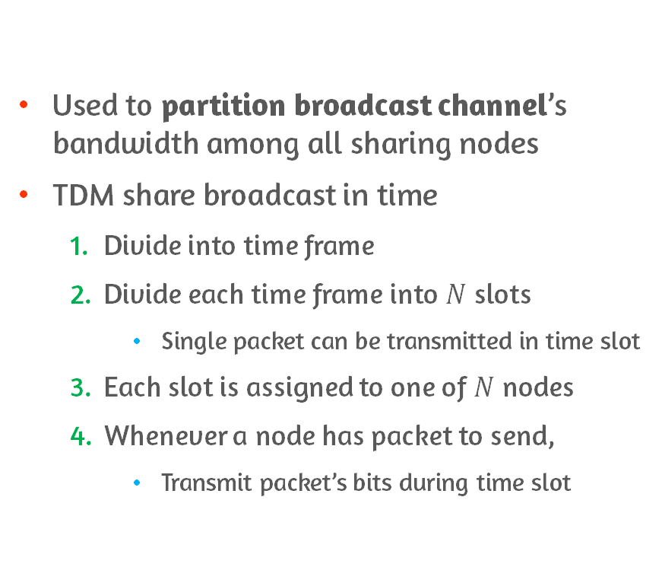
Channel Partitioning Protocols: Time-Division Multiplexing(TDM)
Used to partition broadcast channel’s bandwidth among all sharing nodes
TDM share broadcast in time
Divide into time frame
Divide each time frame into $N$ slots
Single packet can be transmitted in time slot
Each slot is assigned to one of $N$ nodes
Whenever a node has packet to send,
Transmit packet’s bits during time slot

Slide 26
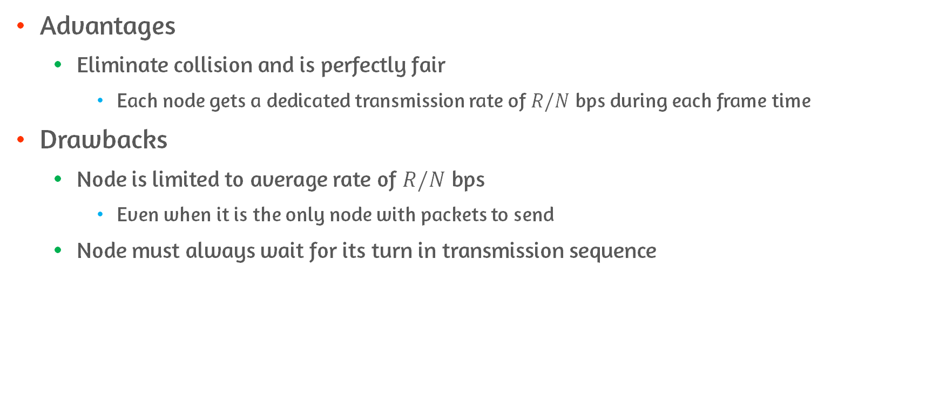
Advantages and Drawbacks of TDM
Advantages
Eliminate collision and is perfectly fair
Each node gets a dedicated transmission rate of $R/N$ bps during each frame time
Drawbacks
Node is limited to average rate of $R/N$ bps
Even when it is the only node with packets to send
Node must always wait for its turn in transmission sequence

Slide 27
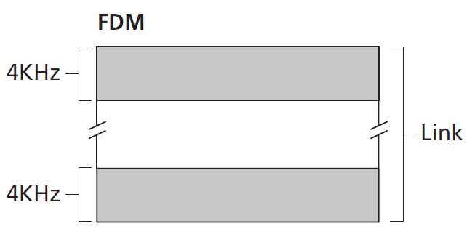
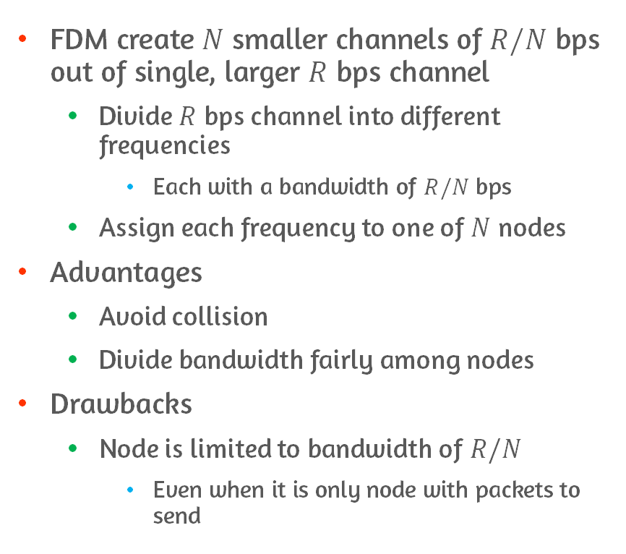
Channel Partitioning Protocols: Frequency-Division Multiplexing(FDM)
FDM create $N$ smaller channels of $R/N$ bps out of single, larger $R$ bps channel
Divide $R$ bps channel into different frequencies
Each with a bandwidth of $R/N$ bps
Assign each frequency to one of $N$ nodes
Advantages
Avoid collision
Divide bandwidth fairly among nodes
Drawbacks
Node is limited to bandwidth of $R/N$
Even when it is only node with packets to send
Notes:
https://talkingaboutme.tistory.com/entry/Signal-Frequency-Division-Multiplexing

Slide 28
Channel Partitioning Protocols: Code Division Multiple Access(CDMA)
Approach
Assign different code to each node
Each node use its unique code to encode data bits
Different nodes can transmit simultaneously
Receivers correctly receive sender’s encoded data bits
Assume receiver knows sender’s code
Particularly use for cellular telephony
Cellular
Mobile telephone system
Notes:
따라서 Channel Partitioning 방법은 네트워크에 있는 기기의 숫자가 정해져 있고, 각각 처리량이 많을 때, 유용한 프로토콜이라고 할 수 있다.

Slide 29
Random Access Protocols
Approach
Transmitting node always transmit at full rate of channel
When there is collision, each node involved in collision repeatedly retransmit its frame
Until its frame gets through without collision
However, it waits a random delay before retransmitting frame
Random delays are independently chosen
So, be able to sneak it frame into channel without collision
Protocols
Slotted Aloha and Aloha
Carrier Sense Multiple Access(CSMA)
Carrier Sense Multiple Access with Collision Detection(CSMA/CD)
Notes:
Get through 통과하다 빠져나가다
Retransmit이 바로 되는 게 아니고, random delay를 거쳐서 한다
- 이게 결국에는 노드마다 다른 delay를 가지고 보내지게 될 거니까
- 서로 시간 차를 두고 보내지게 되는 것

Slide 30
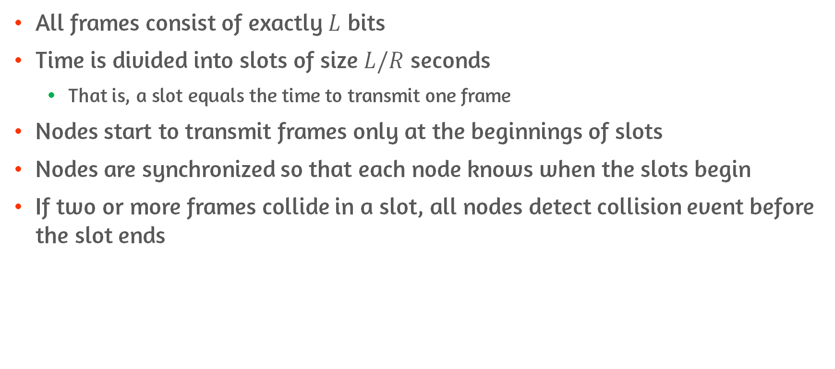
Assumption of Slotted Aloha
All frames consist of exactly $L$ bits
Time is divided into slots of size $L/R$ seconds
That is, a slot equals the time to transmit one frame
Nodes start to transmit frames only at the beginnings of slots
Nodes are synchronized so that each node knows when the slots begin
If two or more frames collide in a slot, all nodes detect collision event before the slot ends

Slide 31
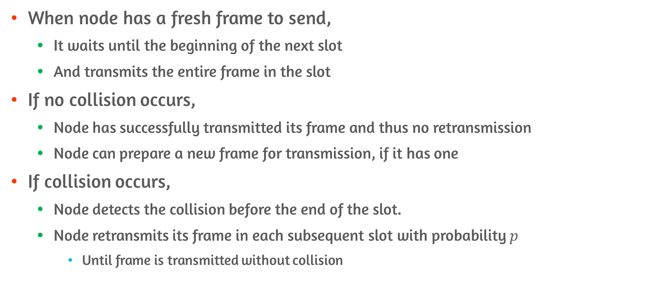
Operation of Slotted Aloha
When node has a fresh frame to send,
It waits until the beginning of the next slot
And transmits the entire frame in the slot
If no collision occurs,
Node has successfully transmitted its frame and thus no retransmission
Node can prepare a new frame for transmission, if it has one
If collision occurs,
Node detects the collision before the end of the slot.
Node retransmits its frame in each subsequent slot with probability $p$
Until frame is transmitted without collision

Slide 32
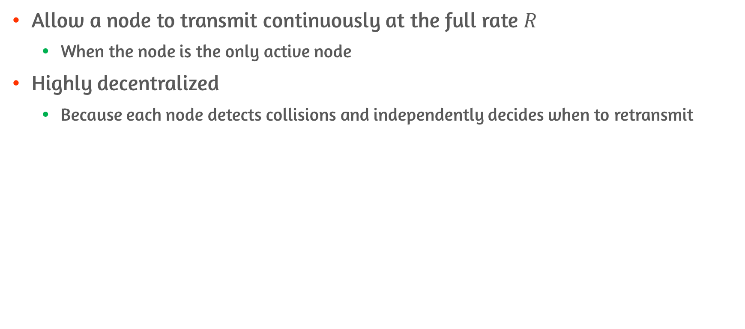
Advantages of Slotted Aloha
Allow a node to transmit continuously at the full rate $R$
When the node is the only active node
Highly decentralized
Because each node detects collisions and independently decides when to retransmit

Slide 33
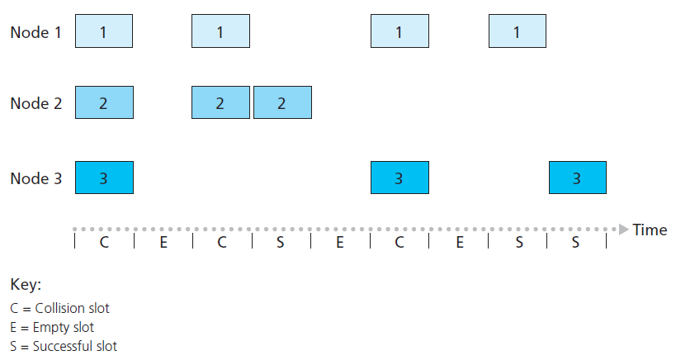
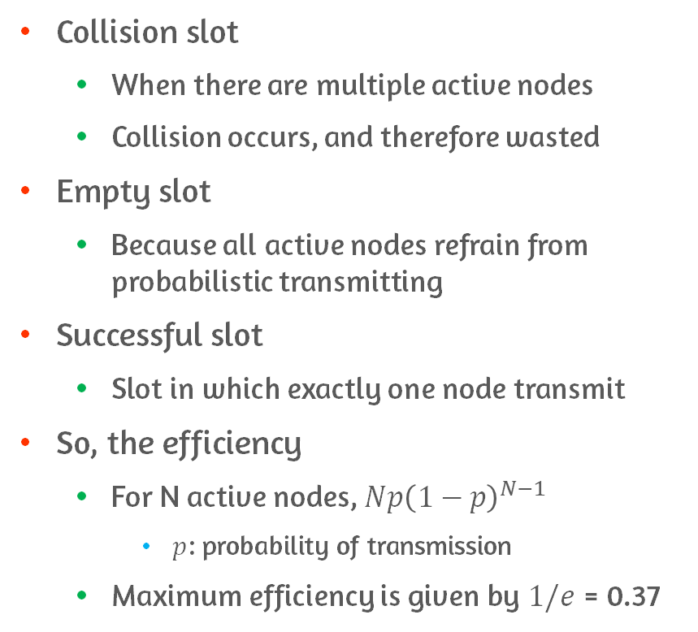
Two Possible Efficiency Concerns
Collision slot
When there are multiple active nodes
Collision occurs, and therefore wasted
Empty slot
Because all active nodes refrain from probabilistic transmitting
Successful slot
Slot in which exactly one node transmit
So, the efficiency
For N active nodes, $Np{\left(1−p\right)}^{N−1}$
$p$: probability of transmission
Maximum efficiency is given by $1/e$ = 0.37
Notes:
Refrain 그만두다
P의 확률로 보낸다고 하면, 1-p의 확률로 안 보낼 수도 있는 것
성공하기 위해서는 1개는 보내야 하고, 나머지는 모두 안 보내야 하니까

Slide 34
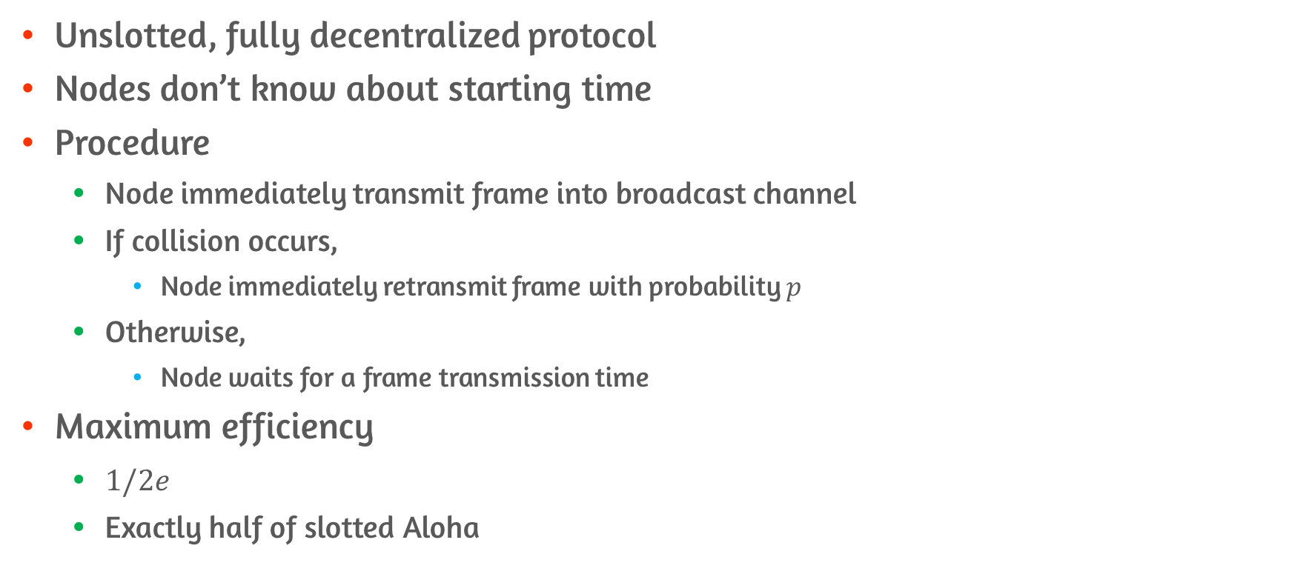
Protocol Before Slotted Aloha: Aloha
Unslotted, fully decentralized protocol
Nodes don’t know about starting time
Procedure
Node immediately transmit frame into broadcast channel
If collision occurs,
Node immediately retransmit frame with probability $p$
Otherwise,
Node waits for a frame transmission time
Maximum efficiency
$1/2e$
Exactly half of slotted Aloha

Slide 35
Rules for CSMA
Carrier sensing
Node listen to the channel before transmitting
If frame is currently being transmitted into channel
Node waits until it detects no transmission
Collision detection
Transmitting node listen to channel while it is transmitting
If it detects that another node is transmitting an interfering frame
Stop transmitting and wait random amount of time

Slide 36
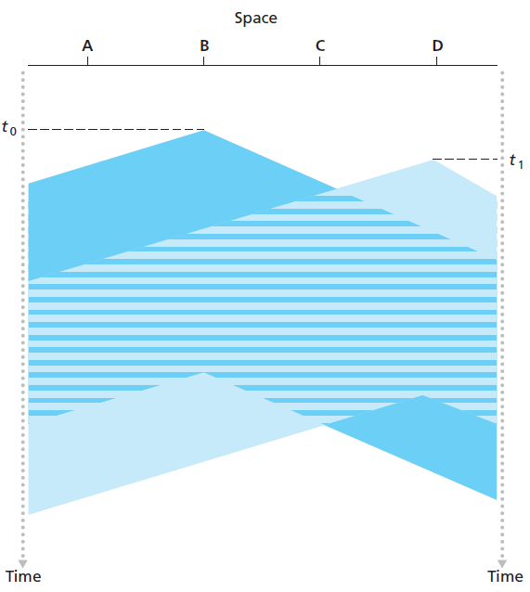
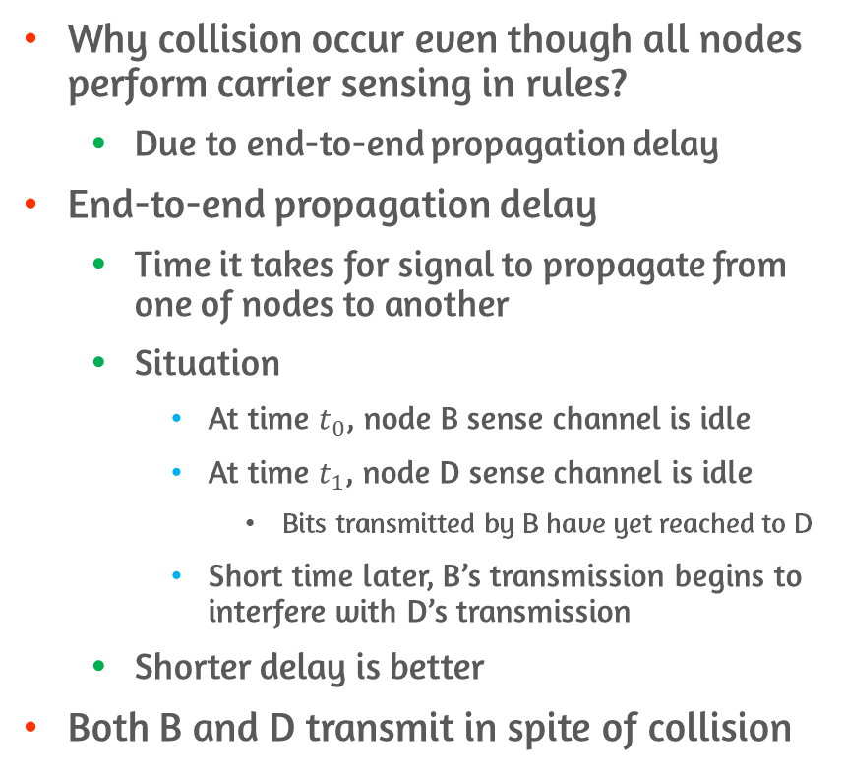
Carrier Sense Multiple Access(CSMA)
Why collision occur even though all nodes perform carrier sensing in rules?
Due to end-to-end propagation delay
End-to-end propagation delay
Time it takes for signal to propagate from one of nodes to another
Situation
At time $t_{0}$, node B sense channel is idle
At time $t_{1}$, node D sense channel is idle
Bits transmitted by B have yet reached to D
Short time later, B’s transmission begins to interfere with D’s transmission
Shorter delay is better
Both B and D transmit in spite of collision

Slide 37
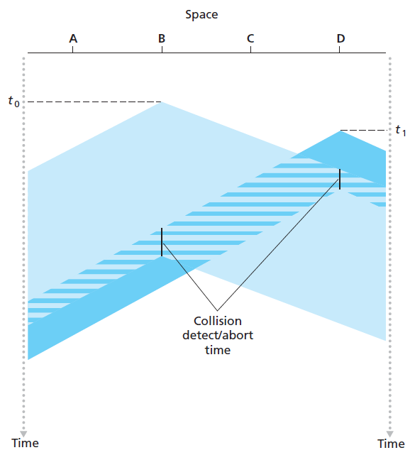
Carrier Sense Multiple Access with Collision Detection(CSMA/CD)
Nodes abort transmission after detecting collision
Not transmitting a useless, damaged frame in its entirety
Operation from perspective of adapter
When adapter obtains datagram,
Prepares a link-layer frame, and puts the frame adapter buffer
If adapter senses that the channel is idle, transmit the frame
Otherwise, wait until it senses no signal energy and then transmit
While transmitting,
Adapter monitors signal from other adapters using the broadcast channel

Slide 38
Carrier Sense Multiple Access with Collision Detection(CSMA/CD)
(Cont.) Operation from perspective of adapter
If adapter transmits entire frame without detecting signal from other adapters,
Adapter is finished with the frame
Otherwise, stops transmitting its frame
After aborting,
Adapter waits a random amount of time and then returns to step 2
Need for random amount of time
If two nodes transmit at the same time, continue colliding forever
Then what is good interval to choose random backoff time?
Notes:
Interval 설정이 적절하게 되어야 하는게,
- 너무 작으면 colliding이 자주 발생
- 너무 크면 node가 오래 기다려야 하니까

Slide 39
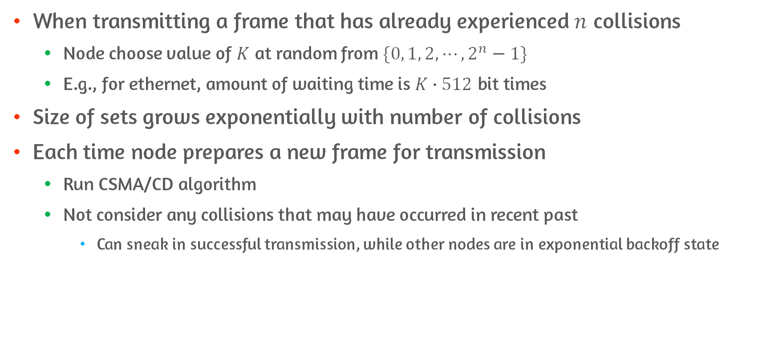
Binary Exponential Backoff
When transmitting a frame that has already experienced $n$ collisions
Node choose value of $K$ at random from $\{0, 1, 2, ⋯, 2^{n}−1\}$
E.g., for ethernet, amount of waiting time is $K∙512$ bit times
Size of sets grows exponentially with number of collisions
Each time node prepares a new frame for transmission
Run CSMA/CD algorithm
Not consider any collisions that may have occurred in recent past
Can sneak in successful transmission, while other nodes are in exponential backoff state

Slide 40
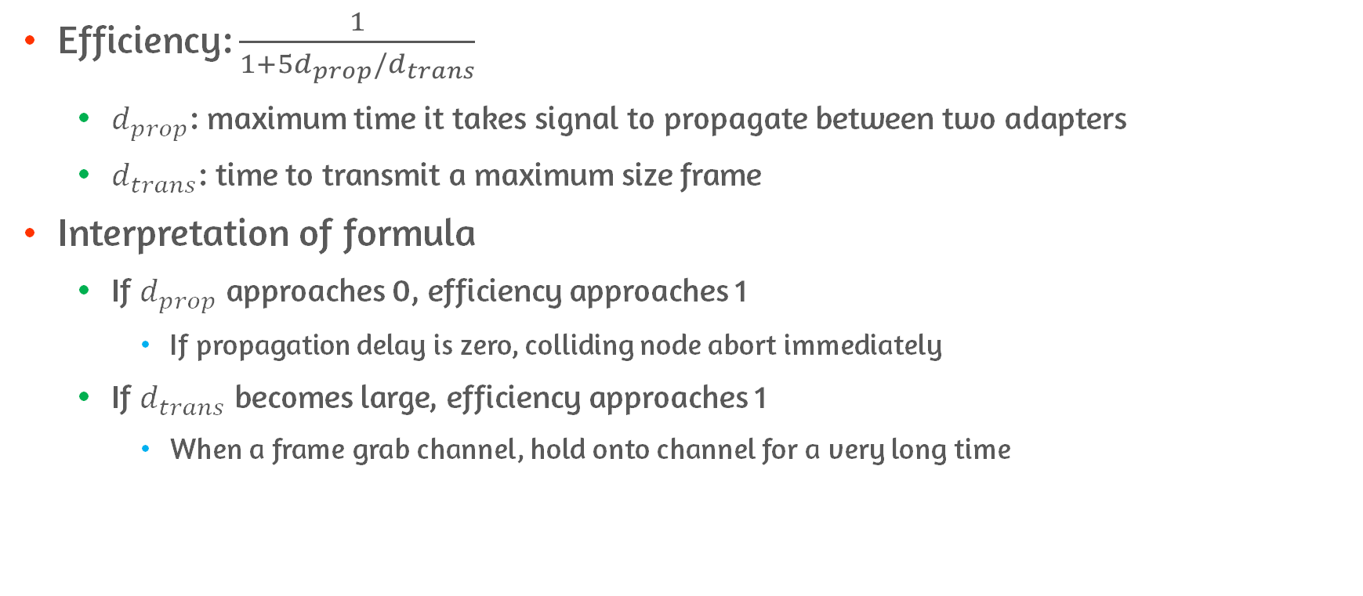
Efficiency of CSMA/CD
Efficiency: $\frac{1}{1+5d_{prop}/d_{trans}}$
$d_{prop}$: maximum time it takes signal to propagate between two adapters
$d_{trans}$: time to transmit a maximum size frame
Interpretation of formula
If $d_{prop}$ approaches 0, efficiency approaches 1
If propagation delay is zero, colliding node abort immediately
If $d_{trans}$ becomes large, efficiency approaches 1
When a frame grab channel, hold onto channel for a very long time
Notes:
Prop: 두 adapter 사이에 propagate하는 데 걸리는 최대 시간
Trans: maximum 크기의 frame 보는데 걸리는 시간

Slide 41
CSMA/CA

Slide 42
CSMA/CA vs CSMA/CD
Instead of using collision detection, it uses collision-avoidance techniques
Once, a station begins to transmit a frame it transmit the frame entirely
No turning back
Uses link-layer acknowledgment/retransmission(ARQ) scheme
Used in wireless environment with relatively high bit error rate

Slide 43
Why Not Implement Collision Detection?
Ability to detect collision requires ability to send and receive at the same time
More costly to implement
Even if the adapter could transmit and listen at the same time, adapter would still not be able to detect all collisions due to hidden terminal problem

Slide 44
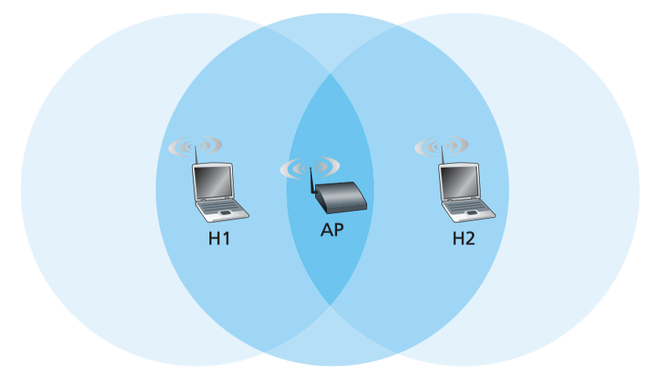
Hidden Terminal Problem
Due to fading each host are hidden from each other although neither is hidden from AP
Host H1 and H2 may send frames at same time to AP causing collision
Cannot detect each other, therefore hidden

Slide 45
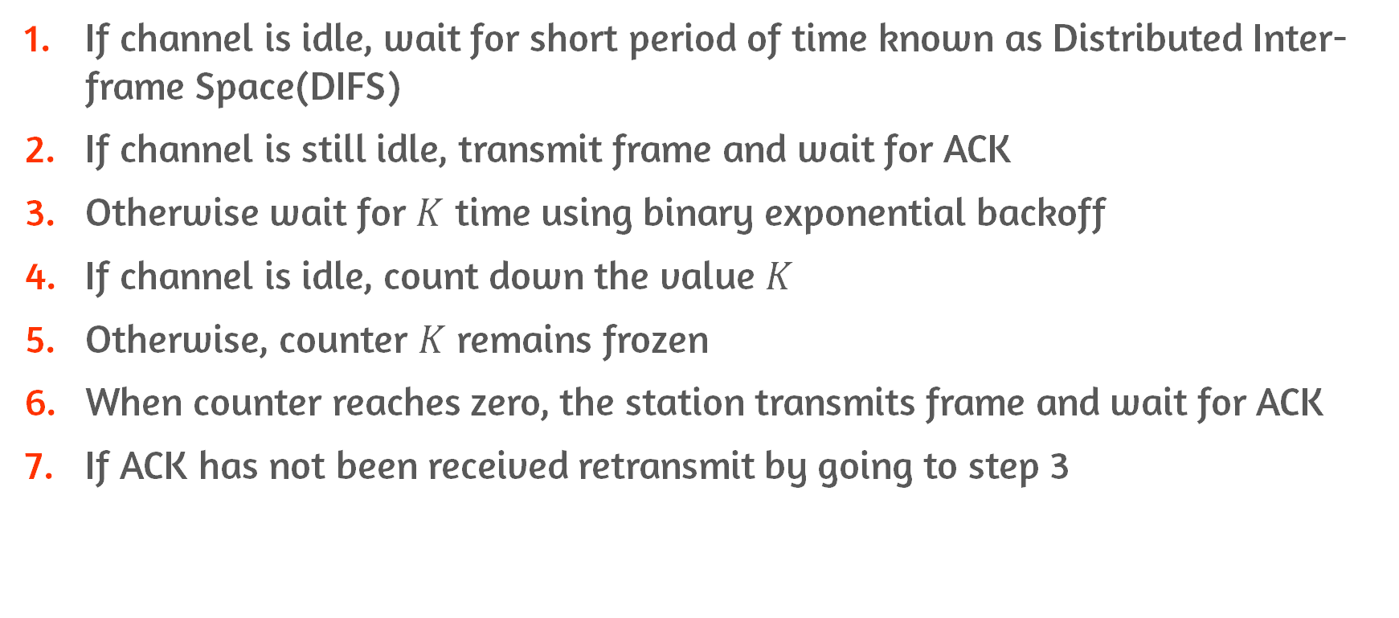
CSMA/CA Procedure
If channel is idle, wait for short period of time known as Distributed Inter-frame Space(DIFS)
If channel is still idle, transmit frame and wait for ACK
Otherwise wait for $K$ time using binary exponential backoff
If channel is idle, count down the value $K$
Otherwise, counter $K$ remains frozen
When counter reaches zero, the station transmits frame and wait for ACK
If ACK has not been received retransmit by going to step 3

Slide 46
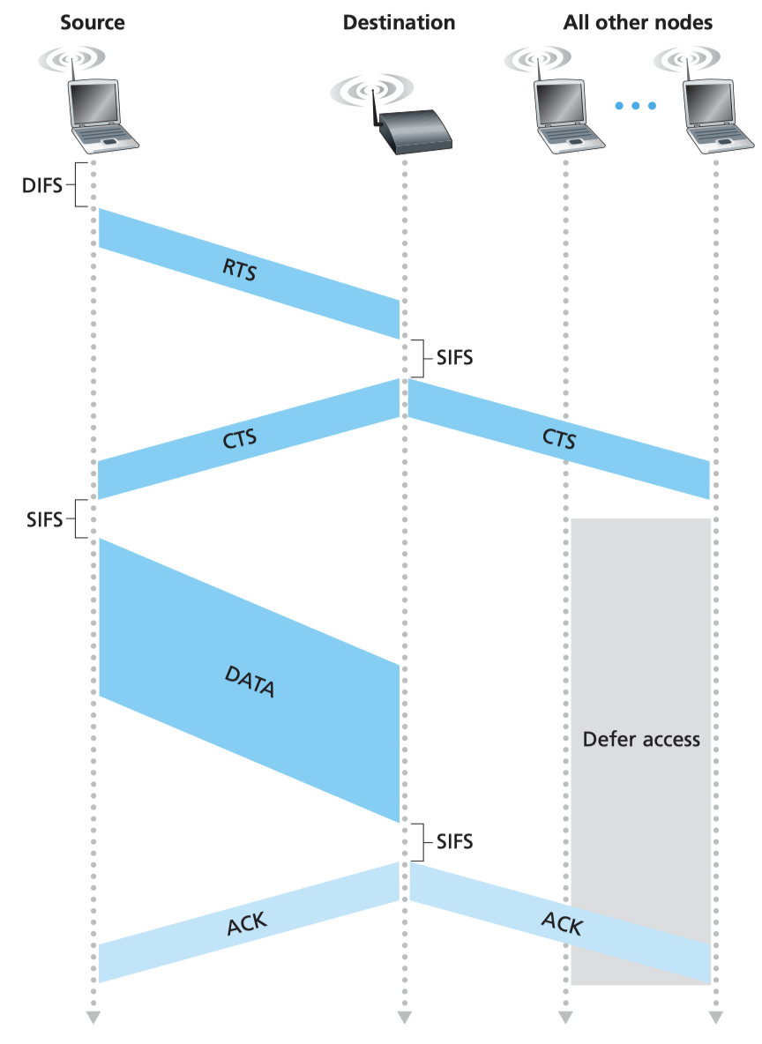
Clear to Send(CTS) & Request to Send(RTS)
Mitigated with short control frames: CTS, RTS
Request to send(RTS)
When sender wants to send data frame, it first broadcast RTS frame
Clear to send(CTS)
When AP receives RTS frame, it responds by broadcasting CTS frame
Two purposes of CTS frame
Give sender explicit permission to send
Instructs other stations to not send for certain amount of time reserved in CTS frame
Since two hosts are in range of AP, hidden terminal problem is mitigated

Slide 47
Taking-Turns Protocols
Aloha and CSMA don’t satisfy property that
When M nodes are active, then each active node has a throughput of nearly R/M bps
This is, the motivation for taking-turns protocols
Taking-turns protocols
Polling protocol
Token-passing protocol

Slide 48
Polling Protocol
Requirement: one of nodes to be designated as master node
Procedure
Master node poll each of the nodes in round-robin fashion
Continue in cyclic manner
Advantages
Eliminate collision and empty slot
Drawbacks
Introduce polling delay
Delay : amount of time required to notify a node that it can transmit
So, node can transmit at a rate less than R bps
If master node fails, entire channel becomes inoperative
Notes:
Polling: 정기적으로 정보를 수집하는 걸 말함
- 나한테 데이터 보낼래? Call 던져서 보내게하는 걸 말함
Round robin fashio으로 동작을 한다는게,
Master가 1번 노드한테 얼마까지 보낼 수 있다고 알리면, 노드 1이 frame들을 보냄
그 후에, 노드 2한테 얼마까지 보낼 수 있다고 하면, 또 노드 2가 frame을 보냄

Slide 49
Token-Passing Protocol
Requirement: token
Procedure
Token is exchanged among nodes in some fixed order
When a node receives a token
If node has frames to send,
Holds onto token
Send up to maximum number of frames and then forward token to next node
Otherwise, immediately forwards token
Problems
Failure of one node can crash entire channel
If a node accidentally neglect to release token, recovery must be invoked
Notes:
여기서 fixed order라는게, 1은 반드시 2에게 token을 보내야하고, 2는 3에게 보내야하고, 이렇게 정해진 순서를 말함

Slide 50
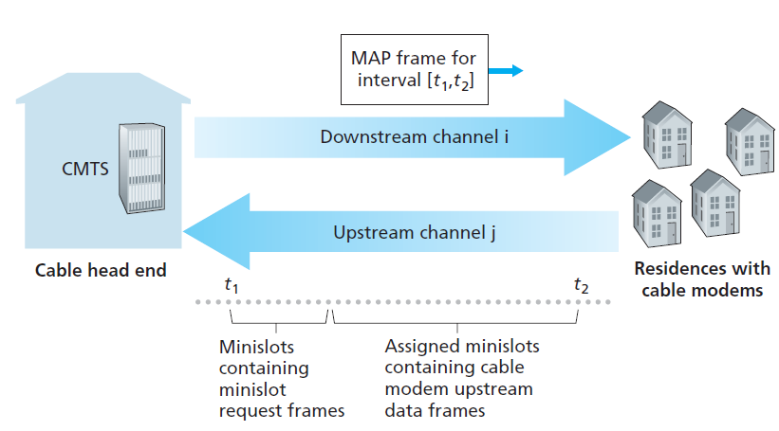
DOCSIS: The Link-Layer Protocol for Cable Internet Access #1
Cable access network
Connect residential cable modems to Cable Modem Termination System(CMTS)
Use FDM
To divide downstream/upstream network segments into multiple frequency channels
Each upstream channel is divided into intervals of time(TDM-like)
Since collision can occur in upstream
CTMS explicitly grants permission to individual modems to transmit during slots
Notes:
FDM이용해서 downstream/upstream segment 나눔
downstream: 6MHZ / upstream 6.4MHz
Downstream에서는 multiple access problem이 발생하지 않음
Upstream에서는 여러 개의 modem이 같은 upstream channel을 공유하기 때문에 collision이 발생할 수 있음
Permission을 주는 방식은 MAP message를 downstream에 보냄

Slide 51
DOCSIS: The Link-Layer Protocol for Cable Internet Access #2
Mini-slot-request frames are transmitted in random access manner
During special set of interval mini-slots
By this request, CMTS can know which cable modems have data to send
Cable Modem assumes
Collision,
If no message received in downstream channel
Use binary exponential backoff to defer retransmission of request
CMTS allocate time slot to each modems centrally
Notes:
FDM이용해서 downstream/upstream segment 나눔
downstream: 6MHZ / upstream 6.4MHz
Downstream에서는 multiple access problem이 발생하지 않음
Upstream에서는 여러 개의 modem이 같은 upstream channel을 공유하기 때문에 collision이 발생할 수 있음
Permission을 주는 방식은 MAP message를 downstream에 보냄
Defer = 미루다

Slide 52
5.4 Switched local area networks

Slide 53
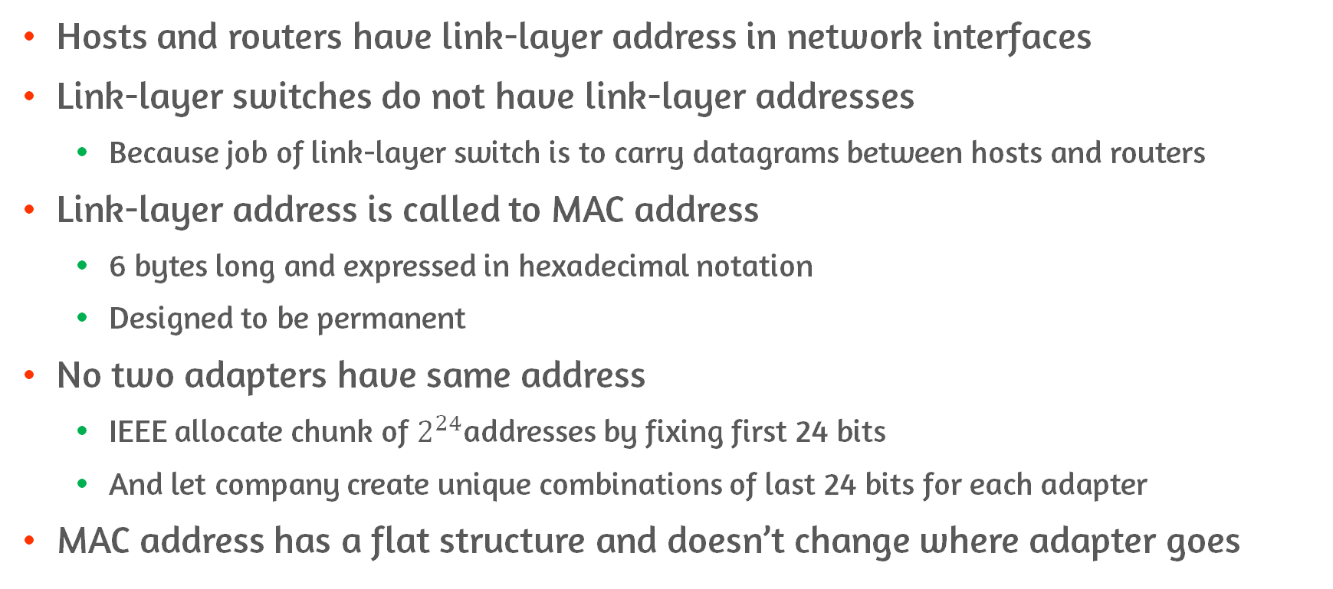
MAC Address and its Feature
Hosts and routers have link-layer address in network interfaces
Link-layer switches do not have link-layer addresses
Because job of link-layer switch is to carry datagrams between hosts and routers
Link-layer address is called to MAC address
6 bytes long and expressed in hexadecimal notation
Designed to be permanent
No two adapters have same address
IEEE allocate chunk of $2^{24}$addresses by fixing first 24 bits
And let company create unique combinations of last 24 bits for each adapter
MAC address has a flat structure and doesn’t change where adapter goes
Notes:
Flat structure는 hierarchy를 가지는 것과 대비대는 특성임

Slide 54
The Reason of MAC Address
LANs are designed for arbitrary network protocols
With MAC address, can support other network protocols
If network address is used instead of MAC address,
Must be changed whenever adapter is moved
Separate address needed for separate layered architecture

Slide 55
Sending/Receiving a Frame Using MAC Address
When adapter want to send a frame
Adapter construct link-layer frame containing destination’s MAC address
For sending to all other adapters, set FF-FF-FF-FF-FF-FF
Send frame into LAN
Switch broadcast incoming frame onto all of its interfaces
When adapter receive a frame
Check whether destination MAC address in frame matches its own MAC address
If match,
Adapter extract datagram and pass it up the protocol stack
Otherwise,
Discard frame without passing up

Slide 56
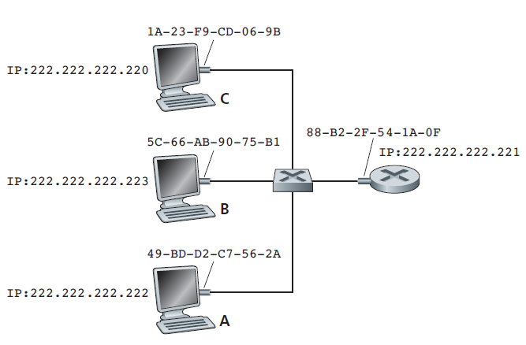
Address Resolution Protocol(ARP)
To send datagram,
Source must give its adapter IP datagram and MAC address for destination
How sender determine MAC address?
Use ARP
Sender provides its ARP module IP address, and ARP module return MAC address
ARP resolve IP addresses only for hosts and router interfaces
On the same subnet
Notes:
MAC address 얻는 방식
- Sending host가 ARP module에 destination IP 얹어서 물어보면, MAC 주소 반환

Slide 57
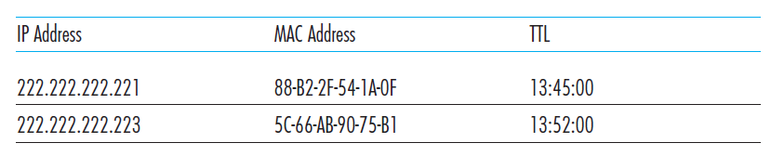
How ARP Works inside of Subnet?
Host and router have ARP table in memory
Contain mapping of IP addresses to MAC addresses
Also, contain time-to-live(TTL)
Indicate when each mapping will be deleted
Not necessarily contain entry for all hosts and routers on subnet
What if ARP table doesn’t have entry for destination?
Use ARP protocol to resolve address
Sender construct ARP query packet
Query all other hosts and routers on subnet to determine MAC address
Use broadcast address
ARP table
Subnet
Notes:
설명 다하고, 어떻게 MAC 주소 얻는지 예시 설명
1. ARP 쿼리가 서브넷에 있는 모든 어댑터에게 보내짐
2. 각 어댑터는 ARP 패킷을 ARP 모듈로 올려 보낸 다음, destination IP 주소와 매칭되는지 확인
3. 매칭되면 MAC 주소 알려주고,
4. ARP table 업데이트하고
5. 이제 그러면 sender가 원하는 대로 보낼 수 있게 됨

Slide 58
Features of ARP
Query ARP message is sent within broadcast frame
Whereas response ARP message is sent within standard frame
ARP is plug-and-play protocol
ARP table gets built automatically
ARP straddles boundary between link and network layers
Notes:
사이라고 생각할 수 있는 이유가
Link layer frame으로 감싸니까, link layer 위에 있다고 볼 수도 있지만,
또 ARP packet 자체에 link layer address 같은 필드 포함하니까 어떻게 보면 link layer protocol이라고 할 수도 있음

Slide 59
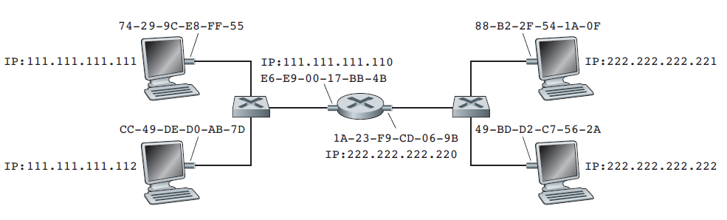
Sending a Datagram off the Subnet #1
Host on subnet 1 send a datagram to host on subnet 2
From 111.111.111.111 to 222.222.222.222
Procedure
Datagram must first be sent to router interface 111.111.111.110
IP address of first-hop router
So, appropriate MAC address is E6-E9-00-17-BB-4B
Obtained by ARP
Router adapter on subnet 1 passes the frame to network layer
And forward into correct interface by forwarding table
Notes:
222.222.222.222의 MAC 주소를 바로 사용하지 않는 것에 주의
- 왜냐? Frame의 destination 주소가 subnet 1에 있는 어떤 어댑터의 주소와도 맞지 않기 때문에 datagram은 죽게 됨

Slide 60
Sending a Datagram off the Subnet #2
(Cont.) Procedure
On forwarded interface
Send datagram into adapter
Encapsulate datagram into new frame
At this time, use MAC address of ultimate destination
Obtained by ARP
Send frame into subnet2
Notes:
222.222.222.222의 MAC 주소를 바로 사용하지 않는 것에 주의
- 왜냐? Frame의 destination 주소가 subnet 1에 있는 어떤 어댑터의 주소와도 맞지 않기 때문에 datagram은 죽게 됨

Slide 61
Comparison of Layers #Transport Layer
Operates on end-to-end hosts
In charge of sending network packets into appropriate applications
Via socket
In charge of congestion control
For the circumstances packet loss/error occurs
Don’t have any idea of how layer below works
Provide logical connection to applications from other hosts
Making Developer’s job much easier

Slide 62
Comparison of Layers #Network Layer
In charge of setting paths using routing algorithm
In charge of interconnecting over the world
For IP protocol, IP address is specified
Layer for large range of sending

Slide 63
Comparison of Layers #Link Layer
In charge of sending between links and links
Solve broadcast channel problem if solved by several hosts at the same time
Represent device’s address by MAC address
Several protocol is provided to avoid signal interference

Slide 64
Conclusion
Understand link layer services and implementation
Three error detection techniques
Parity check
Checksumming
CRC code
Multiple Access Problem
Several protocols
MAC Address

